Slide 1

DATA ANALYSIS AND VISUALIZATION
Week 10: Data Storytelling and Problem Statements
In-Class Activity: Understand the art of data storytelling and constructing effective problem statements.
Assignment: Craft a compelling data story and problem statement for a given dataset

Slide 2

TEACHERS REGISTRATION COUNCIL OF NIGERIA
Data storytelling of
Jigawa TRCN Office Financial report and number of registered Teachers of the year 20323
Lukhman Dahiru
(VOOSTECH LAB FELLOW)
FE/23/52975217

Slide 3

Table of the Content
Introduction
Objective of the Analysis
About the Data
Methodology
Result and insights
Conclusions

Slide 4
Introduction:
In the realm of data analysis, the ability to communicate insights effectively is paramount. The Jigawa TRCN services 2023 sales data, segmented into categories A, B, C, and D, with amount serves as a canvas for unraveling patterns and trends. Through visual storytelling, we embark on a journey to uncover the narrative hidden within the numbers.

Slide 5
Objective of the Analysis
To empower stakeholders with actionable intelligence derived from data visualization, enabling them to navigate the complexities of the market landscape and capitalize on emerging opportunities effectively.

Slide 6
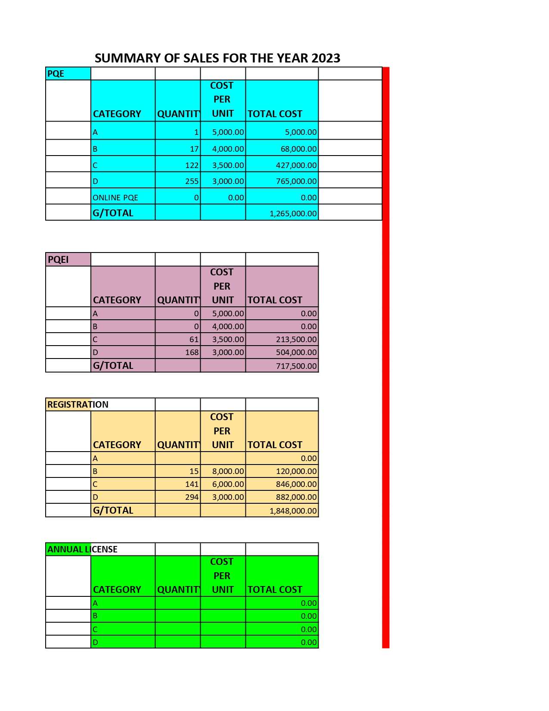
About the Data The data is the sales summary of the whole year 2023 The data comprises the sell of all TRCN services The source of the is monthly sales report of Jigawa TRCN office The dataset used contains the exact sells of the year 2023

Slide 7
Methodology:
The analysis were carried out using Microsoft excel
I used pivot table to perform calculations
And I used column bar chart, pie chart and line chart for the visualization

Slide 8
CATEGORY DISTRIBUTION:
The distribution of sales across categories paints a vivid picture of the market landscape. Category A, representing 1 unit, signifies a niche segment commanding specialized attention. In contrast, the dominance of Category D with 255 units suggests a broader consumer base and potentially higher revenue streams. Categories B and C, with 17 and 122 units respectively, occupy intermediate positions, hinting at varying degrees of market penetration.

Slide 9
PQEI 2023 SALES
The chart shows the category with high and more percentage for professional qualifying examination induction (PQEI) sales in Jigawa TRCN office for the year 2023.

Slide 10
RESGISTRATION 2023 SALES

Slide 11
ANNUAL LICENSE 2023 SALES
The annual license is 0.00% sales in whole year 2023 in Jigawa.

Slide 12
2023 UPGRADING

Slide 13
SALE OF OTHERS
The sales of others is 0.00% sales in whole year 2023 in Jigawa.

Slide 14
CUMULATIVE SALE FOR THE YEAR 2023

Slide 15
REGISTERED TEACHERS IN JIGAWA STATE AS OF THE YEAR 2023 ON CATEGORIES (REGULAR AND PQEI)

Slide 16
CONCLUTIONS:
The story of Jigawa TRCN services 2023 sales transcends numbers, weaving a narrative of market dynamics, consumer behavior, and strategic imperatives. Through the lens of data visualization, stakeholders embark on a journey of discovery, unraveling insights that inform decisive action. As we navigate the intricacies of the market landscape, let us harness the power of visual storytelling to unlock the untold stories within the data.
This report encapsulates the essence of PQE, PQEI, UPGRADING, ANNUAL LICENSE and Others 2023 sales, offering a holistic perspective that empowers stakeholders to navigate the complexities of the market landscape with clarity and confidence.

